Slide 1
Automated Flux Reader (AFR)
Team 513
April 4, 2024

Slide 2
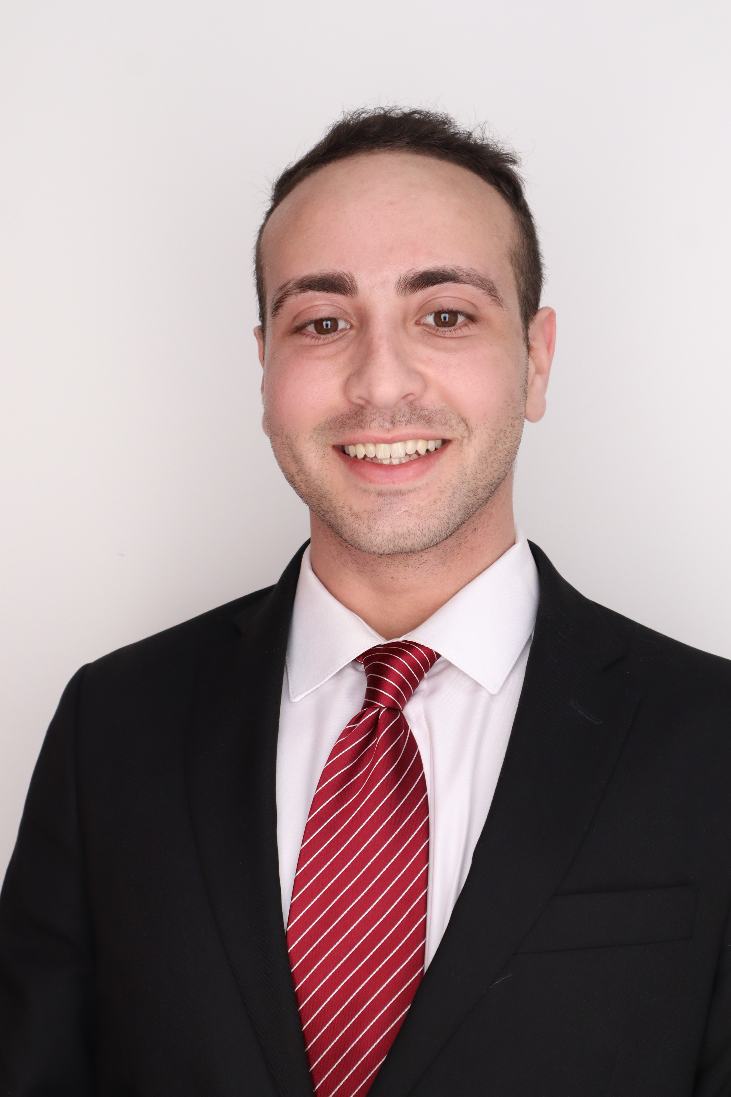
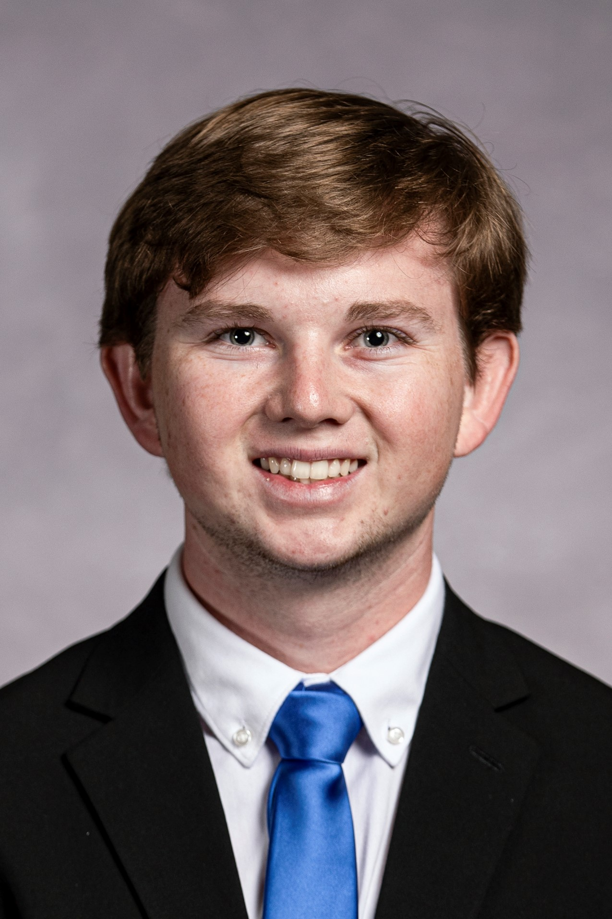
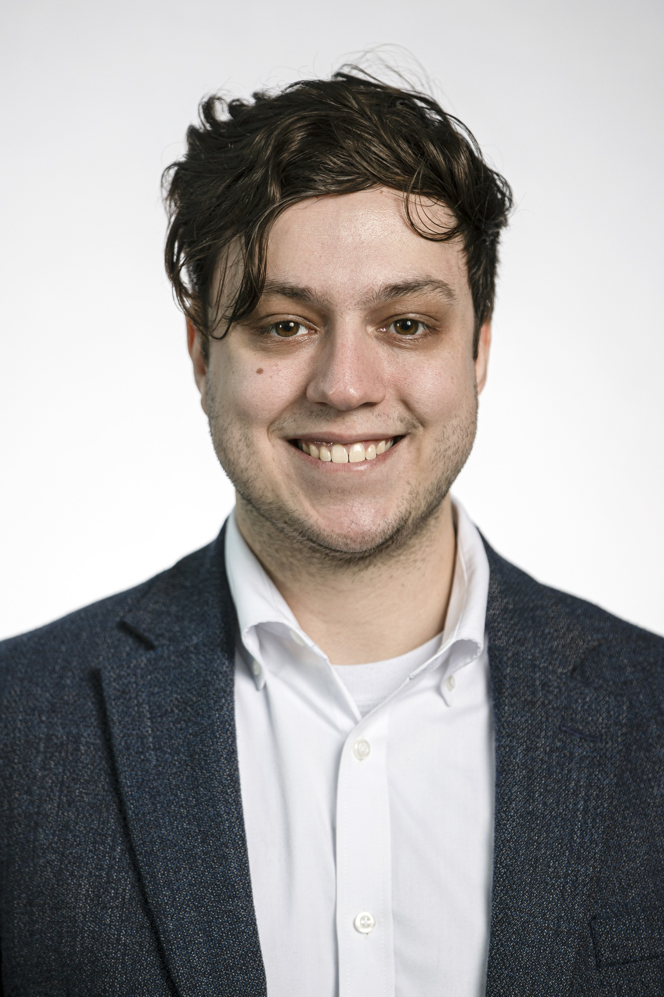
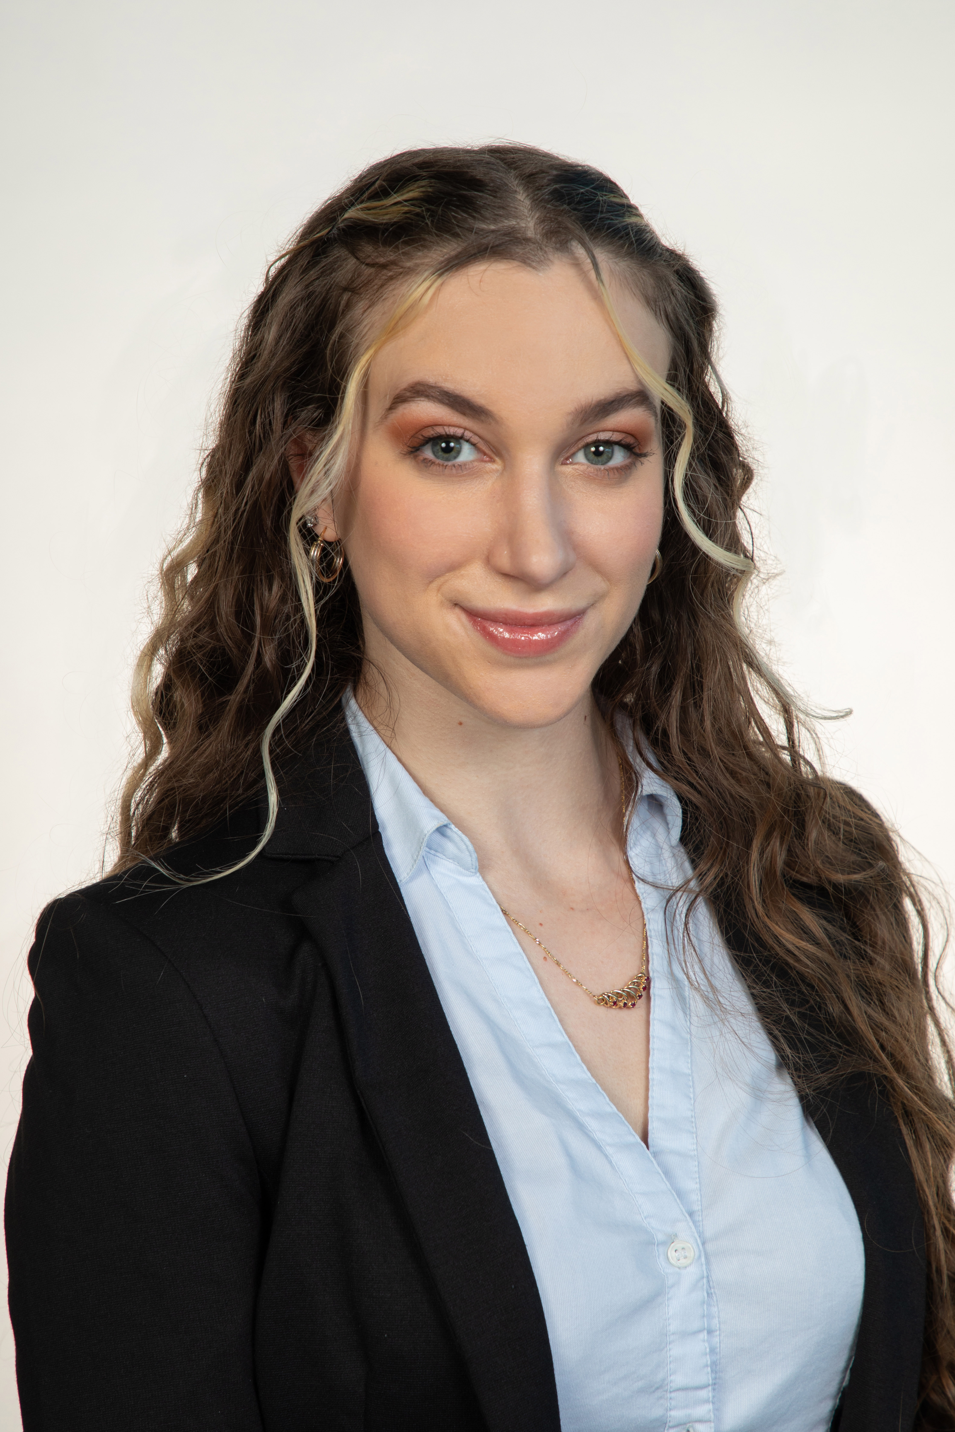
Team Introductions
Liora Louis
Andrew Atallah
Hardware & Software
Engineer
Sean Hemstreet
Design Engineer
Joshua Huls
Systems Engineer
Liora Louis
Materials &
Test Engineer

Slide 3
Sponsor and Advisor
Liora Louis
Engineering Mentor
William Bilbow
Director of Technology & Project Manager
Engineering Mentor
Cole Gray
Mechanical Design Engineer

Slide 4
Objective
Liora Louis
The objective of this project is to design a device that will be capable of fully measuring and recording the magnetic flux of compressor shafts in an automated way that allows for accurate measurements, repeatability, and less overall firsthand work for the operator.

Slide 5
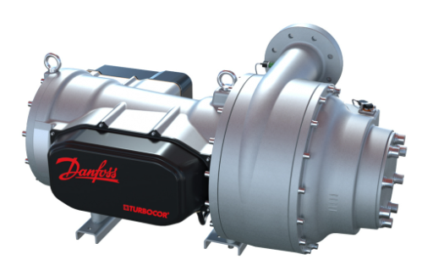
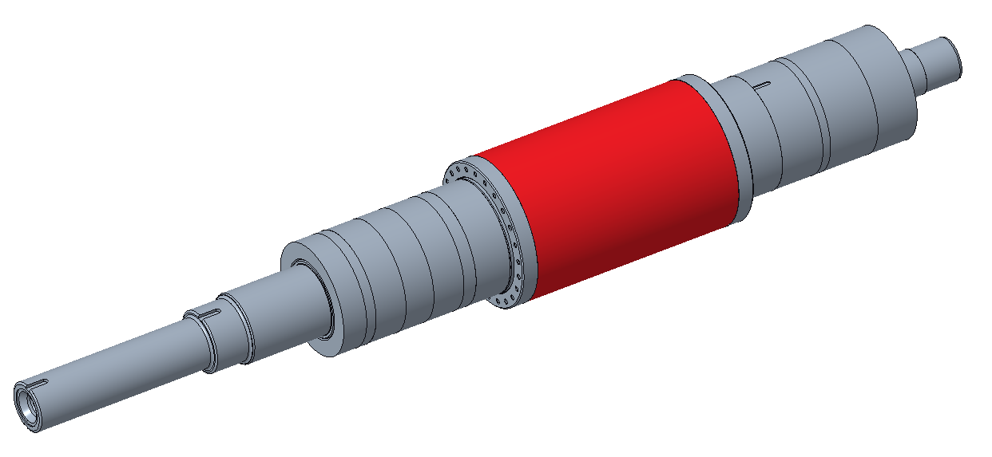
Background
Liora Louis
Compressors deliver high efficiency and low sound levels
Oil-free magnetic bearing
Previous manual method was inconsistent and work intensive

Slide 6
Key Goals
Liora Louis
Automation
Consistency
Adaptability
Accuracy

Slide 7
Assumptions
Liora Louis
Device will be used infrequently.
Open-source software.
Given one working fluxmeter and sensor.
Testing can be performed at Danfoss.
Operator will be able to load shaft onto device.

Slide 8
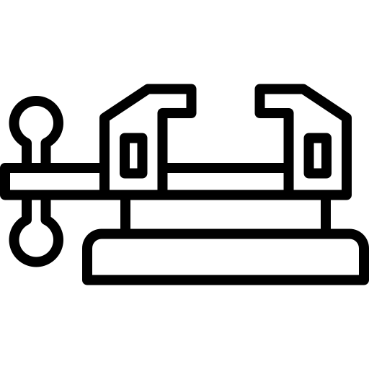
Targets and Metrics
Liora Louis
Secures Sample
Structural Durability
Resolution (5mm)
Repeatability
Data Transfer

Slide 9
Concept Generation
Liora Louis
An in-depth process involving multiple team meetings in which team members produced design ideas together and discussed individuals' ideas as a team to compile a list of wildly varying designs.
Anti-Problem
Biomimicry
Crapshoot
Forced Analogy
Brainstorming

Slide 10
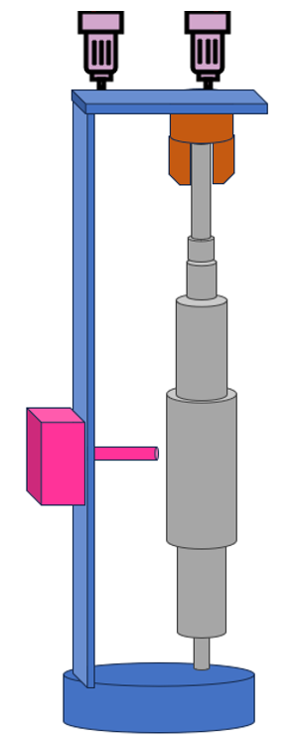
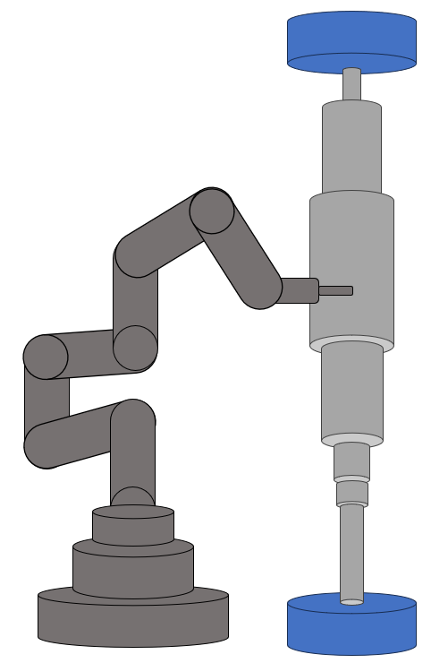
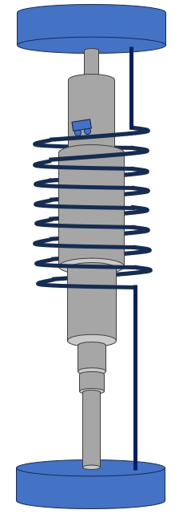
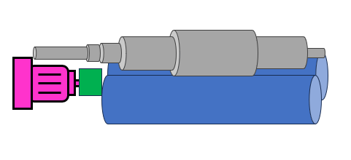
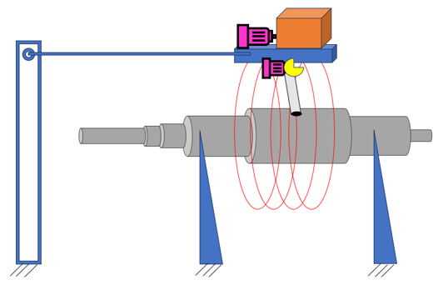
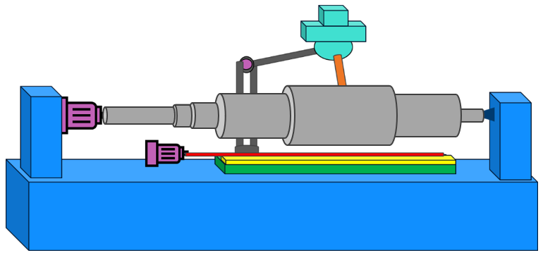
Concept Selection
Liora Louis
Binary Pairwise Comparison
House of Quality (HoQ)
Pugh Charts
Analytical Hierarchy Process (AHP)

Slide 11
Selected Concept
Sean Hemstreet
Reliable Feedback
Consistent Measurements
Measures Entire Region
Secures and Levels Sample
Horizontal Lathe
Adaptable

Slide 12
Initial Design
Sean Hemstreet
Design Elements
Two Triangle Bracket Supports
1
Custom Chuck Head Assembly
2
Live Center
3
Tracks to Move the Brackets
4
Linear Guide Rail
5

Slide 13
Second Design Iteration
Sean Hemstreet
3-Inch Aluminum Blocks

Slide 14
Second Design Iteration
Sean Hemstreet
Wheel for Adjustability
Singular Lever Lock

Slide 15
Second Design Iteration
Sean Hemstreet
Chuck Head
Gear Belt
Stepper Motor

Slide 16
Final Design Iteration
Sean Hemstreet

Slide 17
Final Design Iteration
Sean Hemstreet
Gear Belt Cover

Slide 18
Final Design Iteration
Sean Hemstreet
Measuring Top of Shaft
0.5-Inch Aluminum Blocks

Slide 19
Fluxmeter Probe Housing
Joshua Huls
Hinge for moving probe out of way during specimen loading
Notes:
2 positions, open and closed to move the sensitive and delicate sensor probe out of the way when loading

Slide 20
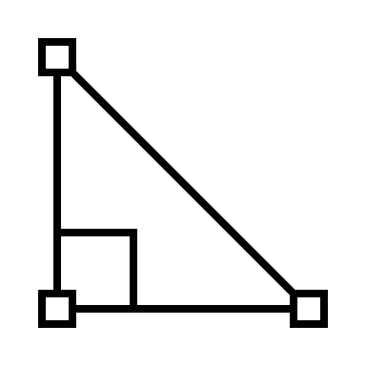
Fluxmeter Probe Housing
Joshua Huls
Probe rest to reinforce sensor probe angle
Notes:
2 positions, open and closed to move the sensitive and delicate sensor probe out of the way when loading

Slide 21
Fluxmeter Probe Housing
Joshua Huls
Adjustable height for use with VT or TT series shafts
Notes:
2 positions, open and closed to move the sensitive and delicate sensor probe out of the way when loading

Slide 22
Operation
Andrew Atallah
Shaft is loaded via crane
User opens the computer application
Click Start
Electronics Connected
User selects the type of shaft being measured

Slide 23
Computer Application
Andrew Atallah
Measure
Send
Sleep
Graph

Slide 24
Arduino Program
Andrew Atallah
“RIGHT” Signal
Moves Platform
5 mm
“ROTATE” Signal
Rotates Shaft
5 mm
“LEFT” Signal
Moves Platform
5 mm

Slide 25
Hardware Setup
Andrew Atallah
Set-up Sensors and
Switches
Motor Driver
Motor Driver
Stepper Motor
Power Supply
Stepper Motor

Slide 26
Testing and Validation
Andrew Atallah

Slide 27
Budget
Andrew Atallah
Remaining Budget
Structural Components
$9,600
$2,400
$1,700
$700
Money Spent
Electronics

Slide 28
Lessons Learned
Joshua Huls
Planning ahead is important
Be prepared for setbacks
Keep moving
Ensure parts ordered fit

Slide 29
Automated Flux Reader
Joshua Huls
Andrew Atallah
aatallah@fsu.edu
Sean Hemstreet
sph19@fsu.edu
Joshua Huls
jth18b@fsu.edu
Liora Louis
llouis@fsu.edu

Slide 30
This is 10-point
This is 15–point Times
This is 20–point
This is 25–point
This is 30–point
This is 35–point
This is 40–point
This is 50–point
This is 60–point
This is 72–point
Notes:
Use at least 20-point font in Room A105, B134, and B136
Use at least 25-point font in Room B135

Slide 31
College of Engineering Color Palette
1 2 3 4
Pantone: PMS 195 C
RGB: 120, 47, 64
Hex: #782F40
CMYK:19, 90, 50, 55
1 2 3 4
Pantone: Black C
RGB: 0, 0, 0
Hex: #000000
CMYK:0, 0, 0, 100
Garnet
Black
1 2 3 4
RGB: 238, 118, 36
Hex: #EE7624
CMYK:2, 66, 99, 0
1 2 3 4
Pantone: PMS 000C
RGB: 255, 255, 255
Hex: #FFFFFF
CMYK: 0, 0, 0, 0
Fang
Orange
White
Notes:
Avoid 75% Black in B135

Slide 32
Accent Color Palette
1 2 3 4
RGB: 0, 59, 111
Hex: #003B6F
CMYK:
1 2 3 4
RGB: 0, 59, 111
Hex: #003B6F
CMYK:
1 2 3 4
RGB: 251, 236, 93
Hex: #FBEC5D
CMYK:
1 2 3 4
RGB: 219, 215, 210
Hex: #DBD7D2
CMYK:
1 2 3 4
RGB: 251, 236, 93
Hex: #FBEC5D
CMYK:
1 2 3 4
RGB: 219, 215, 210
Hex: #DBD7D2
CMYK:
Tardis Blue
Tardis Blue
Corn
Timberwolf
Corn
Timberwolf
1 2 3 4
RGB: 206, 0, 88
Hex: #CE0058
CMYK: 0, 100, 43, 12
1 2 3 4
RGB: 206, 0, 88
Hex: #CE0058
CMYK: 0, 100, 43, 12
1 2 3 4
RGB: 104, 40, 96
Hex: #682860
CMYK:
1 2 3 4
RGB: 220, 220, 220
Hex: #DCDCDC
CMYK:
Rubine Red
Rubine Red
Imperial
Gainsboro
1 2 3 4
RGB: 72, 146, 155
Hex: #48929b
CMYK:
1 2 3 4
RGB: 64, 224, 208
Hex: #40E0D0
CMYK:
1 2 3 4
RGB: 255, 139, 0
Hex: #FF8B00
CMYK:
Asagi-iro
Turquoise
American Orange
Notes:
Remove American orange add hyperlink grey
Make corn the last for b135
All work in 134 imperial move later
Tardis doesn’t work in b136

Slide 33
F7AB19
D67F15
EE7624
D64615
F73119
Analogous
https://color.adobe.com/create/color-wheel
6E3610
F0A16C
EE7624
6E4931
BASB1C
Monochromatic
A14508
4BED3B
EE7624
250CED
2010A1
Triad
A1470C
FF8C40
EE7624
0098A1
24E2ED
Complementary
28A164
2FED8D
EE7624
0848A1
1871ED
Split Complementary
EDAC2F
3BED93
EE7624
0C6AED
ED2F18
Double Split Complementary
ED660C
C7ED3B
EE7624
0CE1ED
A418ED
Square
BA7E09
87724A
EE7624
60EFCF
09BA61
Compound
AD551A
6E3610
EE7624
FA7625
D46820
Shades
Notes:
These are the variants that work well with Fang Orange. The bolded items show well on the projectors.

Slide 34
85412D
8F3831
782f40
8F3176
792D85
Analogous
https://color.adobe.com/create/color-wheel
C44D69
8E626D
782F40
C48796
451B25
Monochromatic
C43959
78743B
782F40
236178
43A2C4
Triad
C43959
C46078
782F40
25C43D
2F783A
Complementary
93C460
577835
782F40
39C49D
297861
Split Complementary
784435
5A783B
782F40
237860
6E2978
Double Split Complementary
782337
78683b
782F40
237830
293978
Square
AB4D32
DEBAAF
782F40
5D8555
70AB32
Compound
38161E
C44D69
782F40
853447
5E2532
Shades

Slide 35
A105
A105
B135 Stage Left
B135 Stage Right
B136
B134, A105
B135

